Slide 1
Challenges in Distance learning (COLIBRI experiences)

Slide 2
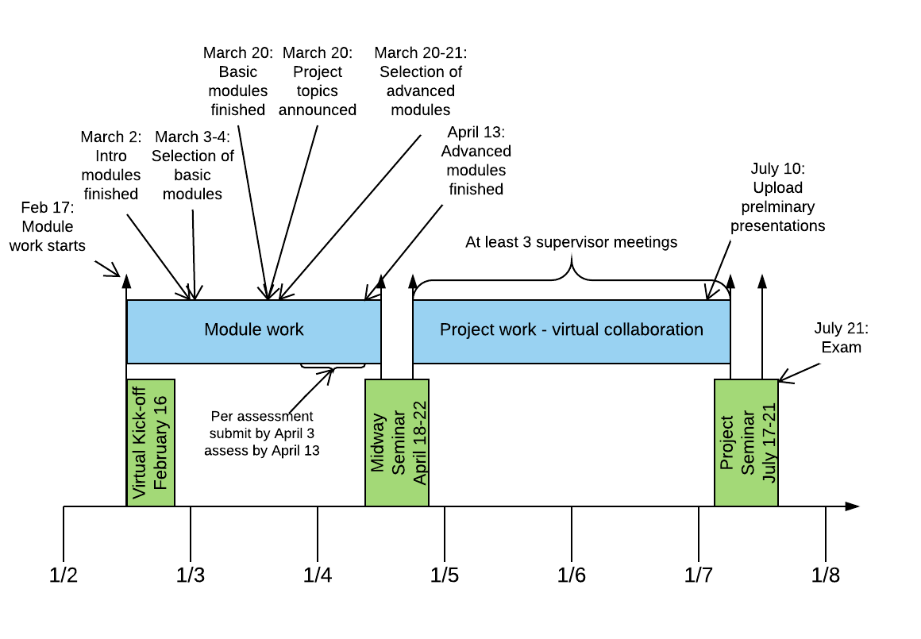
The COLIBRI course

Slide 3
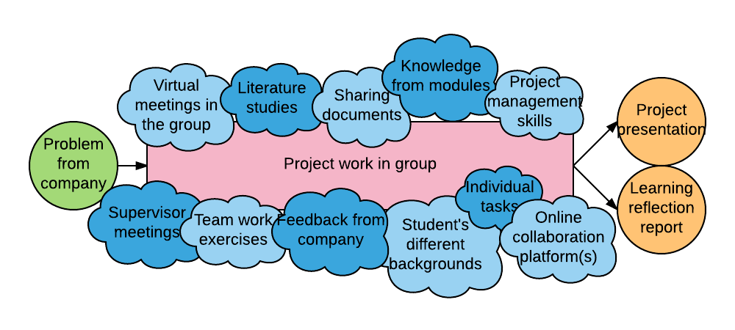
The project work

Slide 4
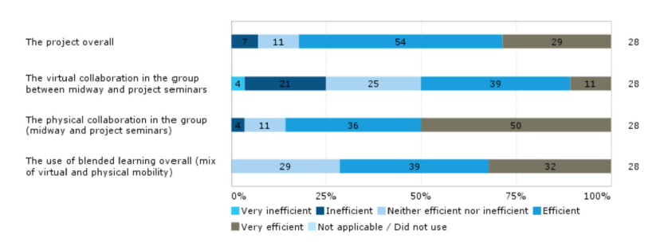
Seminars: Efficient throughout

Slide 5
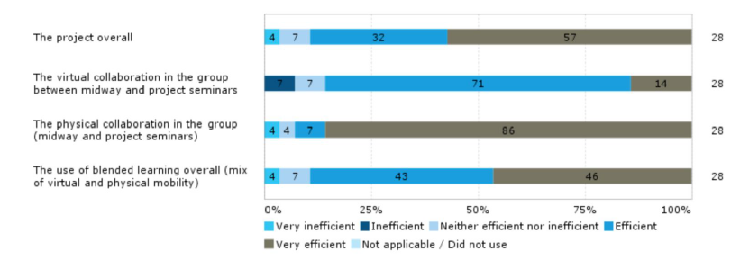
Virtual collaboration: not so easy!

Slide 6
Our recommendations…
Spend the time wisely at the seminar.
Get to know each other well – good atmosphere.
Get a good, joint problem understanding.
Joint view on the project and the process.
Agree on precise milestones (maybe meetings).
Involve your supervisor(s) on project content, process, and milestones.
Use the templates provided – they will help you structure the process.
Structured follow-up on progress is crucial.

